Slide 1
Don’t Wait ‘til it's too late
Andrew White
Founding Director

Slide 2
Our Story
Hawkesbury Deﬁb Project Deﬁbrillator's Save Lives
Educa+ng and Empowering Communi+es.
This presentation will take about 10 minutes;
That’s about time you have to save a life should one of your oﬃcials, players or spectators experience Sudden Cardiac Arrest;
In 2010 it was one too many deaths I witnessed when Stephen
Buckman, a young man died at footy training;
As a MICA paramedic there was a drive within me to make a diﬀerence to reduce what was happening in the community;
I could no longer sit here and wait ‘til it's too late, so Deﬁb For Life, a not-­‐for-­‐proﬁt organisation was established.

Slide 3
Deﬁb For Life Vision
Hawkesbury Deﬁb Project Deﬁbrillator's Save Lives
Educa+ng and Empowering Communi+es.
We educate communities across Australia to access early deﬁbrillation knowing it's imperative to improving outcomes from an unexpected Sudden Cardiac Arrest;
To save lives by ensuring as many people as possible throughout
the community in public places have access to automa,c deﬁbrilla,on;
By installing a deﬁbrillator into your sporting facility, you will be ensuring your community is prepared for the worst.

Slide 4
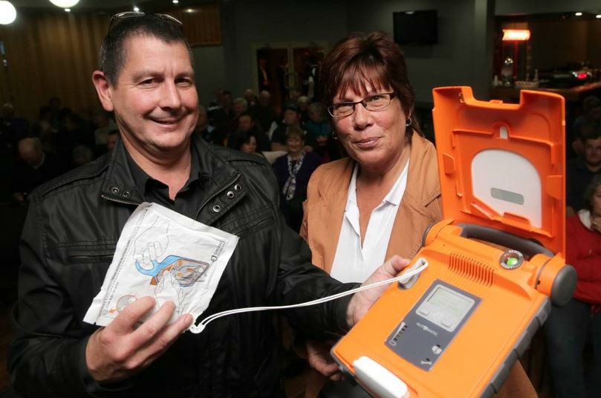

Slide 5
The Issue
Hawkesbury Deﬁb Project Deﬁbrillator's Save Lives
Educa+ng and Empowering Communi+es.
Sudden Cardiac Arrest
Over 33,000 out of hospital Sudden Cardiac Arrests events occur each year
12 young people every week die
18 times more than the national road toll
11 times more than those who die from breast cancer
It doesn’t discriminate – it is our biggest killer

Slide 6
Hawkesbury Deﬁb Project Deﬁbrillator's Save Lives
Educa+ng and Empowering Communi+es.
What Is Sudden Cardiac Arrest?
It is a sudden change in the electrical component of the heart
The faulty electrical system stops the heart muscle from pumping blood to the bodies vital organs
Within seconds of this occurring the victim becomes unconscious and they are classed as clinically dead at this point
Every minute that passes without deﬁbrillation, there is a 10% less chance of survival;
CPR is needed but it does not restart the heart – only a defibrillation
will;
If no shock is given within 10 minutes, a victim will have less than 10% chance of survival

Slide 7
Hawkesbury Deﬁb Project Deﬁbrillator's Save Lives
Educa+ng and Empowering Communi+es.
The Risk
This doesn’t discriminate – players, oﬃcials, staﬀ, parents, grandparents
Sudden Cardiac Arrests, there is no warning;
1 in 300 of us are walking around with a cardiac condi,on that is yet to be diagnosed;
Unless emergency services respond with a deﬁbrillator within 10
mins the chance of death is over 90%;
For many of us help is not far away, but the average ambulance response and arrival ,me can vary around Australia from
10-­‐12minutes, and for a SCA, its just too late.

Slide 8
Hawkesbury Deﬁb Project Deﬁbrillator's Save Lives
Educa+ng and Empowering Communi+es.
Your Community
Who owns the risk?
Football NSW?
The Club?
The facility owner?
The individual, the player?
The parents of the player?
Is it an unforeseen incident?
A game, a sporting carnival, a training session, awards presentation, community group function
You own the risk– be part of the solution, protect your community

Slide 9
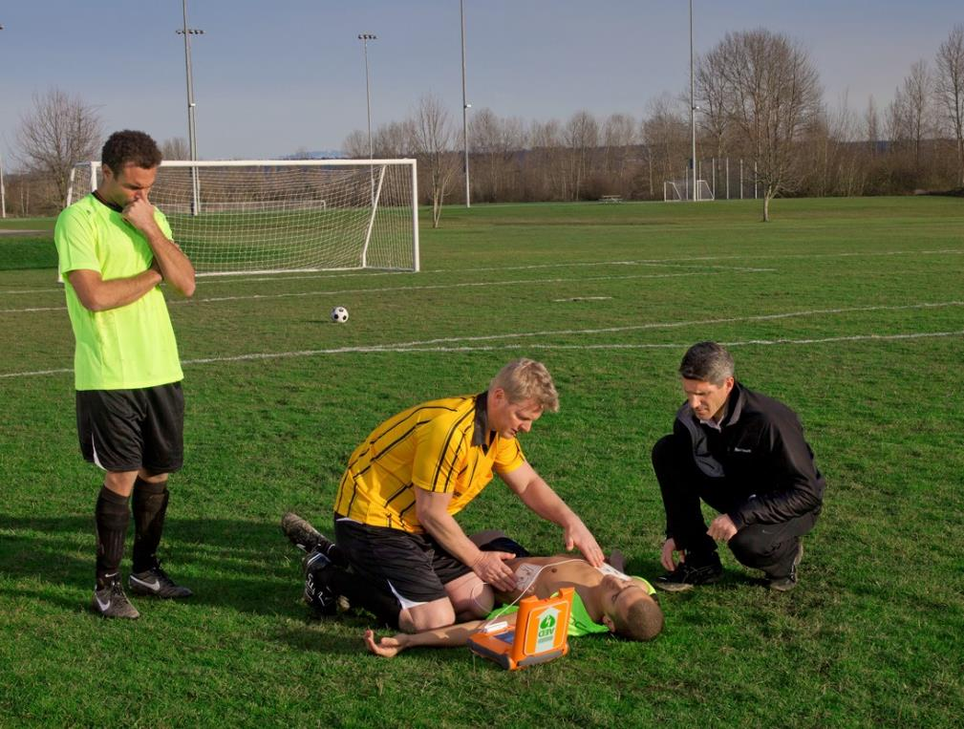
Don’t wait ‘til its too
late!

Slide 10
Be RESCUE READY
Hawkesbury Deﬁb Project Deﬁbrillator's Save Lives
Educa+ng and Empowering Communi+es.
Implement the Chain of Survival; An International standard.
It is vital that a witnesses of a Sudden Cardiac Arrest immediately:
calls 000;
starts CPR and;
applies an automatic external deﬁbrillator (AED);
Many trainers are already accredited to use a deﬁbrillator through their ﬁrst aid requirement.

Slide 11
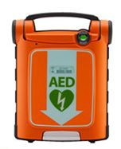
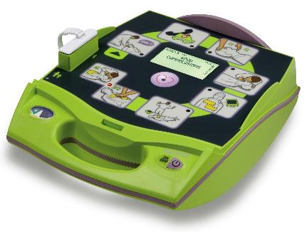
Your Solution
Hawkesbury Deﬁb Project Deﬁbrillator's Save Lives
Educa+ng and Empowering Communi+es.

Slide 12
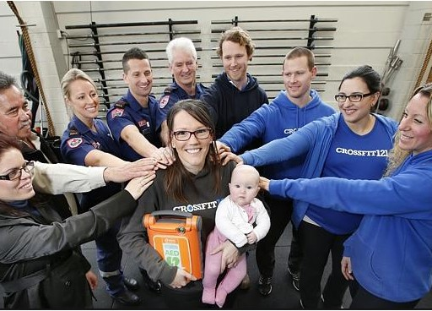

Slide 13
Don’t Wait ‘til it's too late
Andrew White
Founding Director

