Slide 1

A presentation to
Football NSW 2015 Facilities Forum

Slide 2
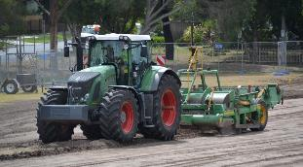
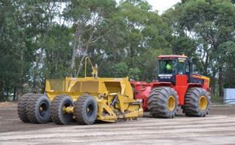
Case Study – Melwood Oval, Forestville.
Warringah City Council
Warringah City Council engaged Turf One for the reconstruction of the natural grass fields at Melwood Oval, Forestville.
Brief included the following :
Design and Construction of two synthetic turf fields to comply with FIFA 1 Star , IRB and AFL/CA regulations.
To prevent flood damage and control stormwater runoff on downstream properties and natural waterways.
To ensure that the proposed re-development does not adversely affect the operational capacity of the downstream stormwater system.
To ensure that the development does not impact on the water quality of adjacent properties or creeks.

Slide 3
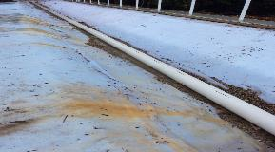
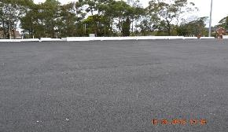
Turf One Solution
Stormwater Solution
The design and construction of a “wedge shaped” porous aggregate rock base, laid over a geo-composite waterproof membrane, ensures that when heavy rains occur, the water passes quickly through the synthetic turf surface and is stored within the wedge shape aggregate rock layer. The aggregate base has a void space of >35% to store stormwater.
The discharge of the captured water was controlled by releasing it through an small outlet in the last pit, before it discharged into the open water way. This prevents the likelihood of flood damage to the environment and down stream dwellings.
The use of aggregates in the base layer, acts as a filter and thus ensures the quality of stormwater flowing into the environment.

Slide 4
Turf One Aggregate Pavement

Slide 5
Turf One Solution
Playing Surface.
The synthetic surface installed at Melwood is FieldTurf’s Elite Revolution 70mm without a shock pad. This product meets all the standards for FIFA, FIH, IRB and AFL.
Revolution is FieldTurf’s latest generation turf that has the following characteristics.
  FIBRE - he revolution Fibre features a polymer formulation which resists splitting and degradation, complete with the strongest ultraviolet inhibitor technology in the industry.
  SEAMS - The patented seaming solution of sown seams, ensures the joins, the weakest part of a field do not come apart.
  Lines – The installation of the lines not tuffed in during the manufacturing process, are hot melt glued. The backing is not cut, but instead the fibre is sheared off, leaving the backing intacked. The new line is then hot glued to the backing material.
  SURE LOCK COATING SYSTEM - allows for 40% of the backing to be porous, thus allowing for water to pass vertically and quickly into the base.
  Infill - FieldTurf have patented a three layered infill system , which provides long term performance and safety characteristics.
  Cork – The cork chosen is durable, impact absorbing and absorbs far less heat than other alternatives. By replacing the top layer of rubber with cork, the field is 20° C cooler.
  .

