Slide 1
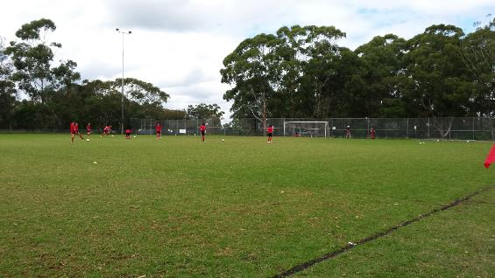
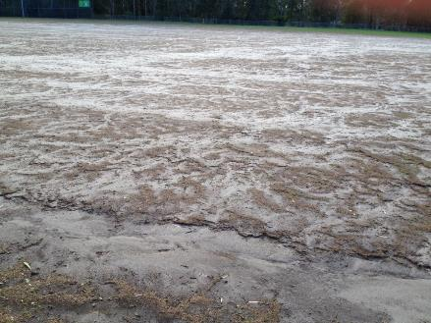
WORKING WITH YOUR LOCAL COUNCIL
PETER KEMP, HORNSBY SHIRE COUNCIL & GRAHAME BATEMAN, PENNANT HILLS FC
Pennant Hills Park No. 3 Oval
April (start of season) August (before end of season)

Slide 2
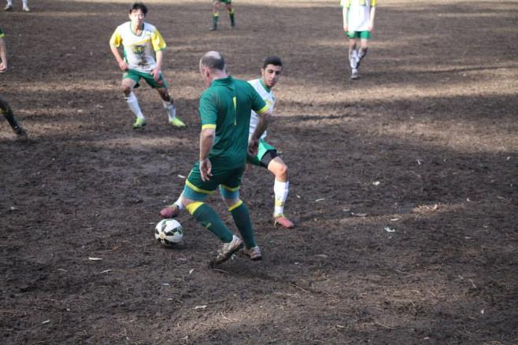
WORKING WITH YOUR LOCAL COUNCIL
GRAHAME BATEMAN, PENNANT HILLS FC
IDENTIFY & QUANTIFY REQUIREMENT – WHY?
Current stats on players, ground availability, safety
Current & potential future users, players, spectators
Income opportunities
RESEARCH AVAILABLE OPTIONS – WHAT?
Understand what you are asking for
Consult FNSW, Council, manufacturers
Economic viability, help with financial model
COORDINATE APPROACH TO COUNCIL – WHO?
Identify community/club spokesperson/champion
Coordinated communication through ‘one voice’
More than one sports user, Persistence
POLITICAL & BUREAUCRATIC AWARENESS
Identify representatives & key decision influencers
Communicate & Lobby

Slide 3
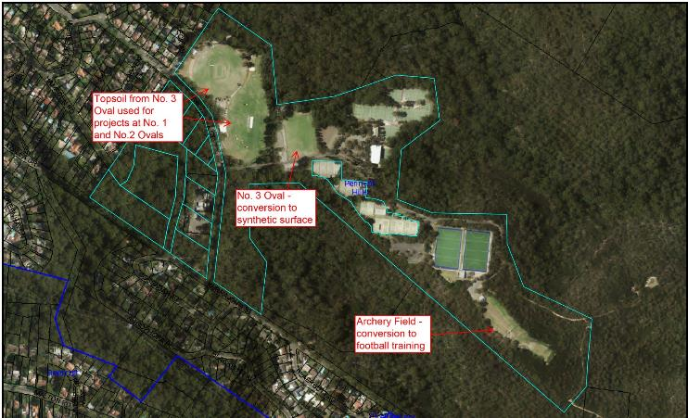
WORKING WITH YOUR LOCAL COUNCIL
PETER KEMP, HORNSBY SHIRE COUNCIL
CONSIDERATIONS
Relative popularity of football to other sports
Acceptance of synthetic surfaces
Sustainability, Availability of Capex
Asset Management – whole of life costs
CHOOSING A SUITABLE SITE
Existing unsustainable turf wear
Football Club keen for change & cooperative
Compatible summer season users incl. Football
FUNDING
Loans/maintenance savings
Development contributions
Government Grants
OPPORTUNITIES
Stormwater harvesting & re-use of topsoil
Improvements to surrounds for all visitors

Slide 4
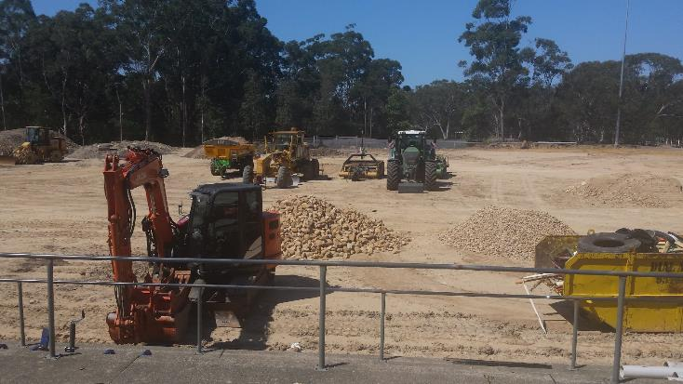
WORKING WITH YOUR LOCAL COUNCIL
PENNANT HILLS PARK No. 3 OVAL
Contractor: Turf One
Total Project Cost: $2.4 million (incl.
road, stormwater drainage, parking,
lights, fencing, ancillary items)
Field Size: 100m x 67m + 3m/4m
Field Revolution 63 elite turf
Start: August 2015
Completion: January 2016

Slide 5
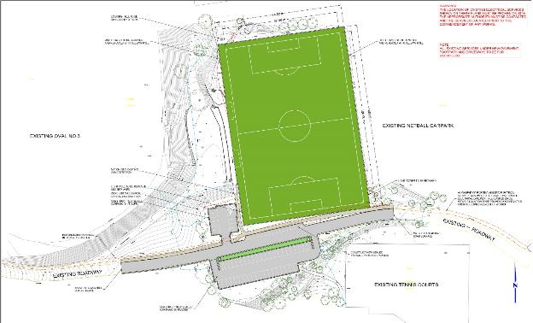
WORKING WITH YOUR LOCAL COUNCIL
PETER KEMP, HORNSBY SHIRE COUNCIL & GRAHAME BATEMAN, PENNANT HILLS FC
KEY LEARNINGS:
MANAGE THE OUTCOME
START & COMPLETION DATES CAREFULLY SET
(to minimise impact on seasons)
UNDERSTAND USER CONSTRAINTS, CARE, MAINTENANCE
PLAN TO MAXIMISE USAGE
(create awareness in diverse groups, 12 months of the year)
SHARE THE FACILITY
COST & FEE CALCULATIONS AND CHARGES
IDENTIFY EXISTING SERVICES & GEOTECH REPORT
(Understand what is underground as early as possible)
SUBGRADE CONDITIONS VERY IMPORTANT
LOOK AT IMPACTS ON SURROUNDING USERS
OPPORTUNITIES TO RE-USE THE TOPSOIL REMOVED
FLEXIBILITY WITH FIELD MARKINGS

